Slide 1
Secure Data Hiding in Images Using Steganography
CAPSTONE PROJECT
Presented By:Shubham Mahadik
College Name & Department : Terna Enginnering College

Slide 2
OUTLINE
Problem Statement
Technology used
Wow factor
End users
Result
Conclusion
Git-hub Link
Future scope

Slide 3
Problem Statement
Traditional methods of hiding data in images, such as Least Significant Bit (LSB) modification, are prone to detection and data corruption. This project proposes a secure and simple method for embedding secret messages into images using pixel manipulation, ensuring basic encryption with a passcode-based authentication system.

Slide 4
Technology used
Programming Language: Python
Libraries: OpenCV, os, string
Platform: Google Colab / Local Machine

Slide 5
Wow factors
✅ Simple yet effective approach to image-based data hiding
✅ Uses passcode protection to prevent unauthorized access
✅ Works with standard JPEG image formats
✅ Lightweight and easy to implement in real-world applications

Slide 6
End users
Cybersecurity Enthusiasts: Learning about steganography
Forensic Analysts: Extracting hidden messages in images
Journalists & Whistleblowers: Secure communication
Students & Researchers: Studying image security methods

Slide 7
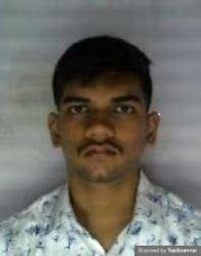
Results
Cover Image: Original image used to hide data

Slide 8
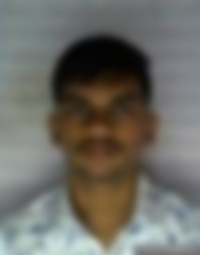
Results
Encoded Image: Visually identical to the cover image but contains a hidden image

Slide 9
Results
Extracted Image: Successfully retrieved hidden image using the trained model
nter secret message:jnkbjjhv;
Enter a passcode:123
Enter passcode for Decryption123
Decryption message: jnkbjjhv;

Slide 10
Conclusion
This project successfully demonstrates a simple and effective approach to image-based steganography using Python. By embedding messages within pixel values and securing them with a passcode, it provides an introduction to secure data hiding while ensuring ease of implementation

Slide 11
GitHub Link
https://github.com/swag64/steganography-project.git

Slide 12
Future scope(optional)
🚀 Enhance security with encryption techniques 📊 Develop a GUI-based application for user-friendly operation 🔍 Implement bit-level modifications for increased stealth 🛡️ Integrate with AI for automatic security assessments

Slide 13
THANK YOU

